Slide 1
TCR ANALYSIS
Pablo de Vicente Abad
Promotor : Pieter Meysman
Supervisor : Vincent Van Deuren

Slide 2
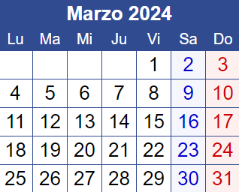
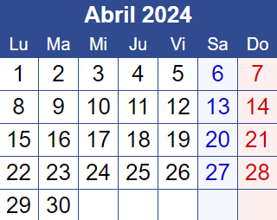
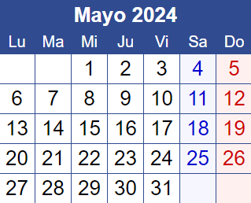
Overview
Biology /
System setup
Data processing
Clustering and analysis

Slide 3
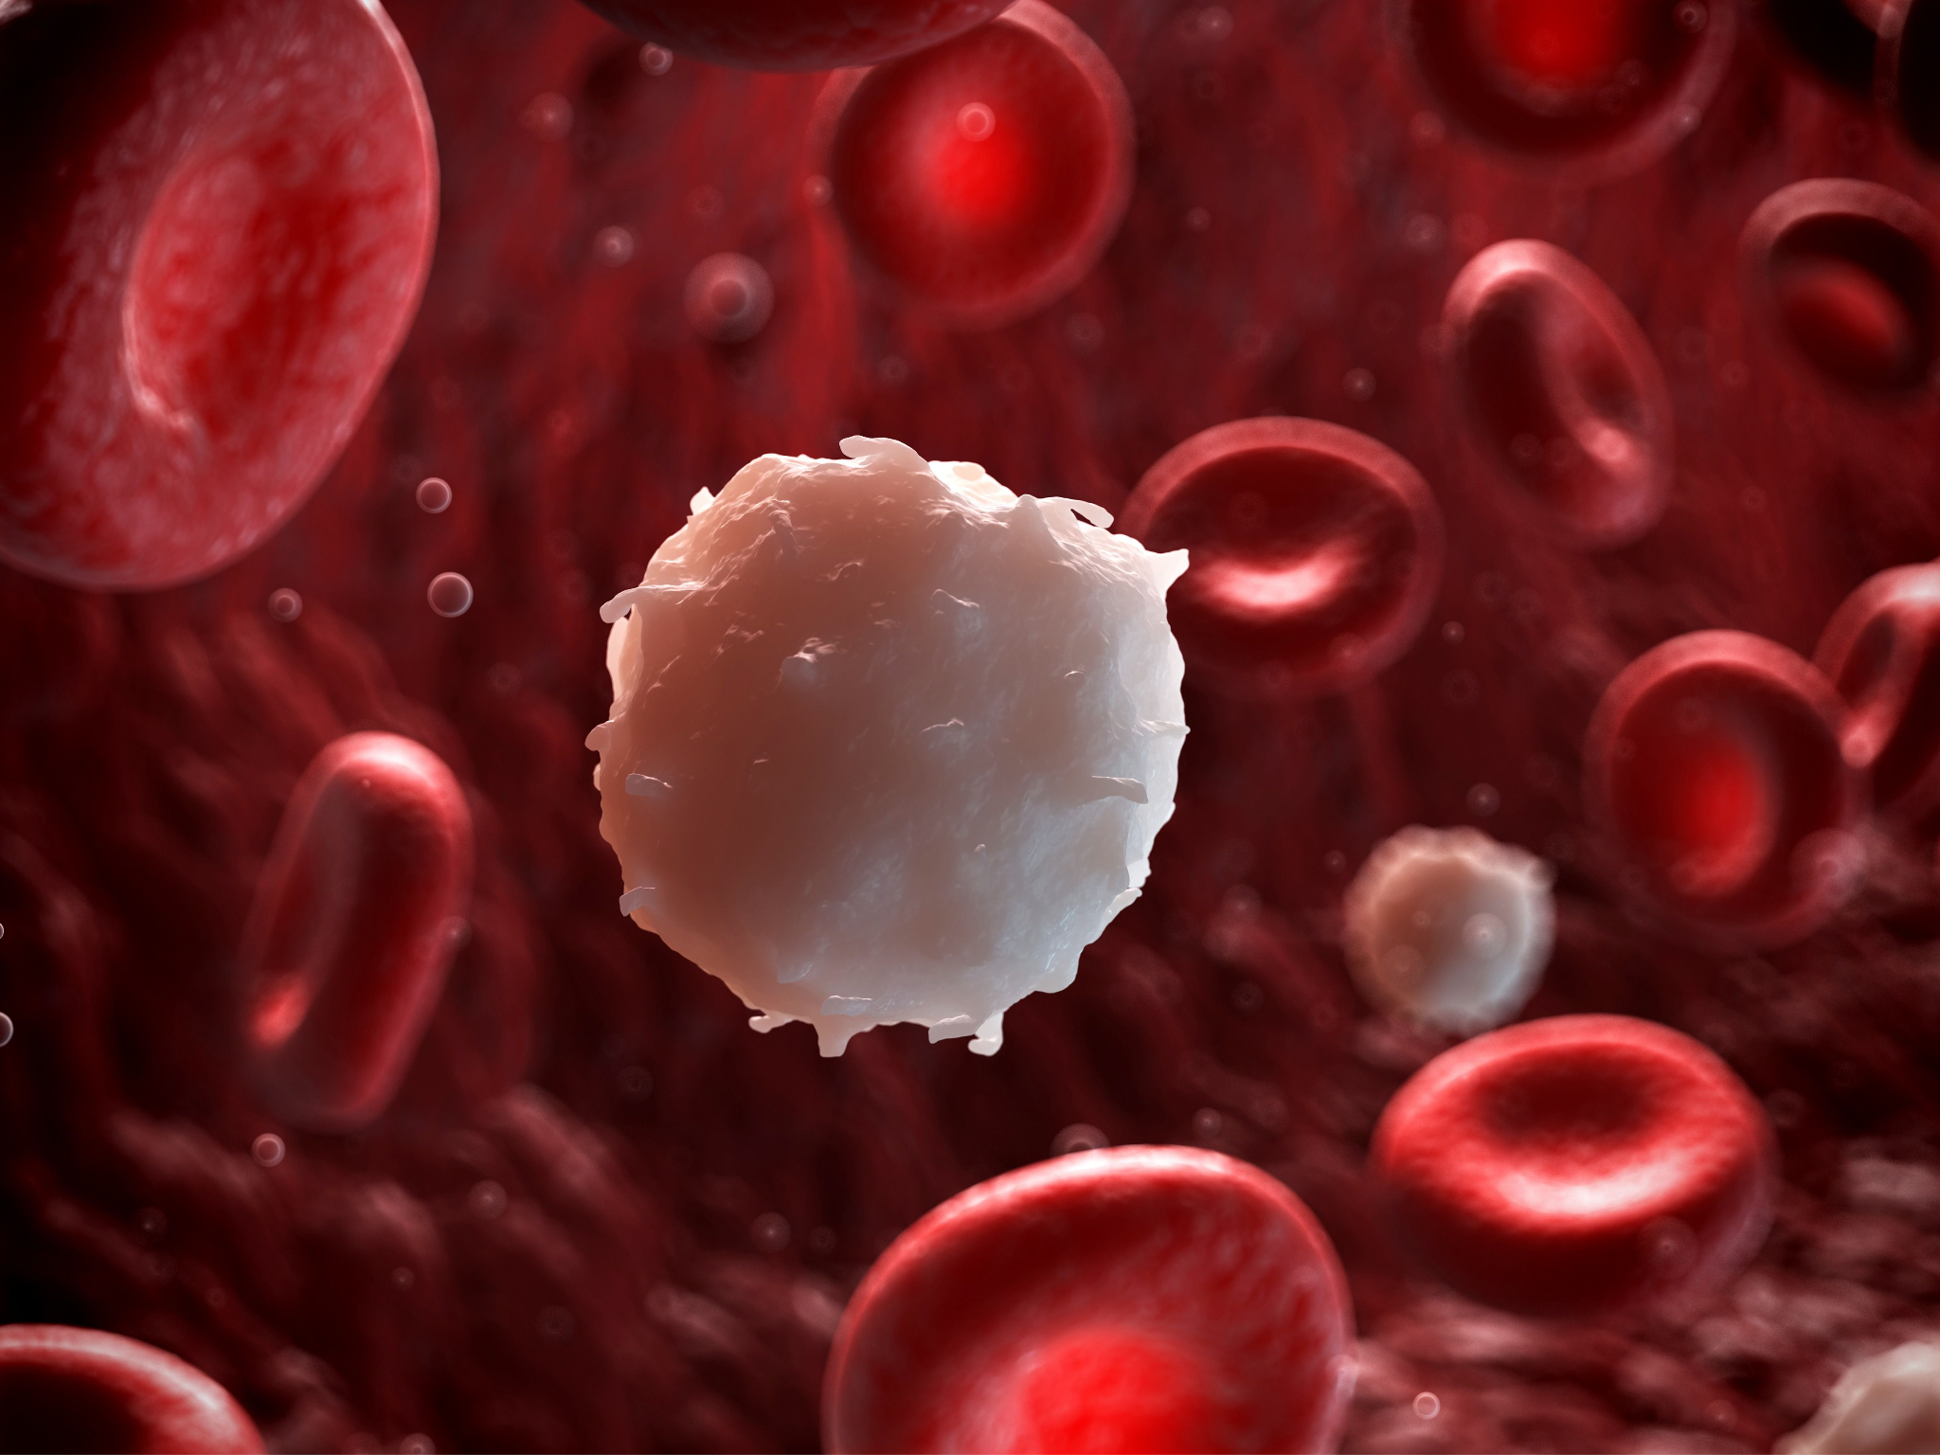
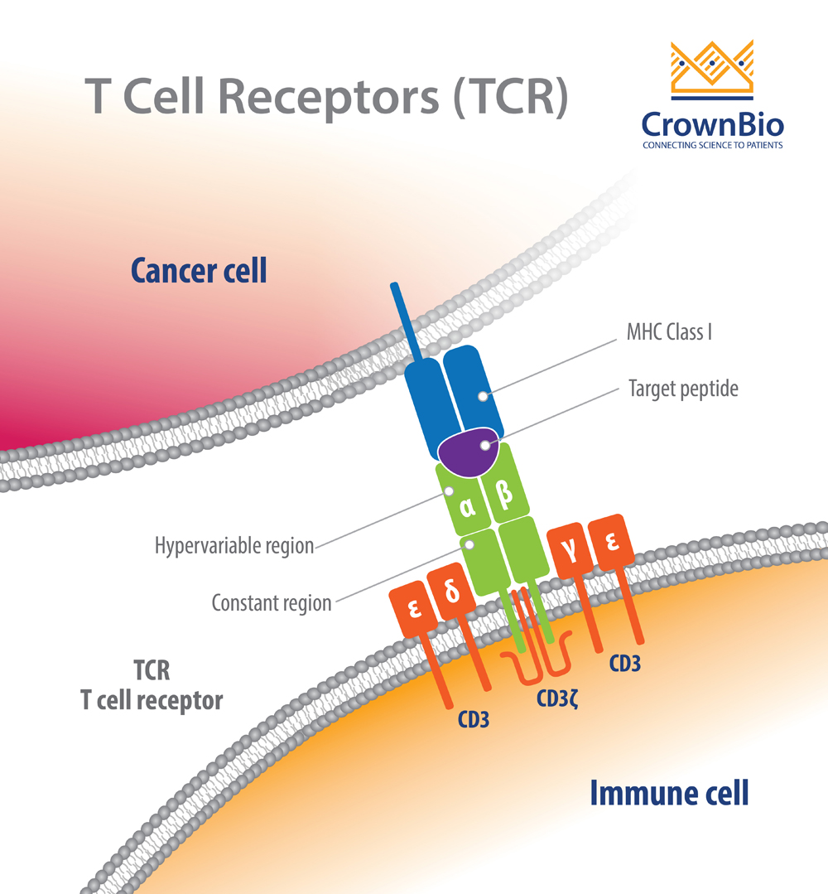
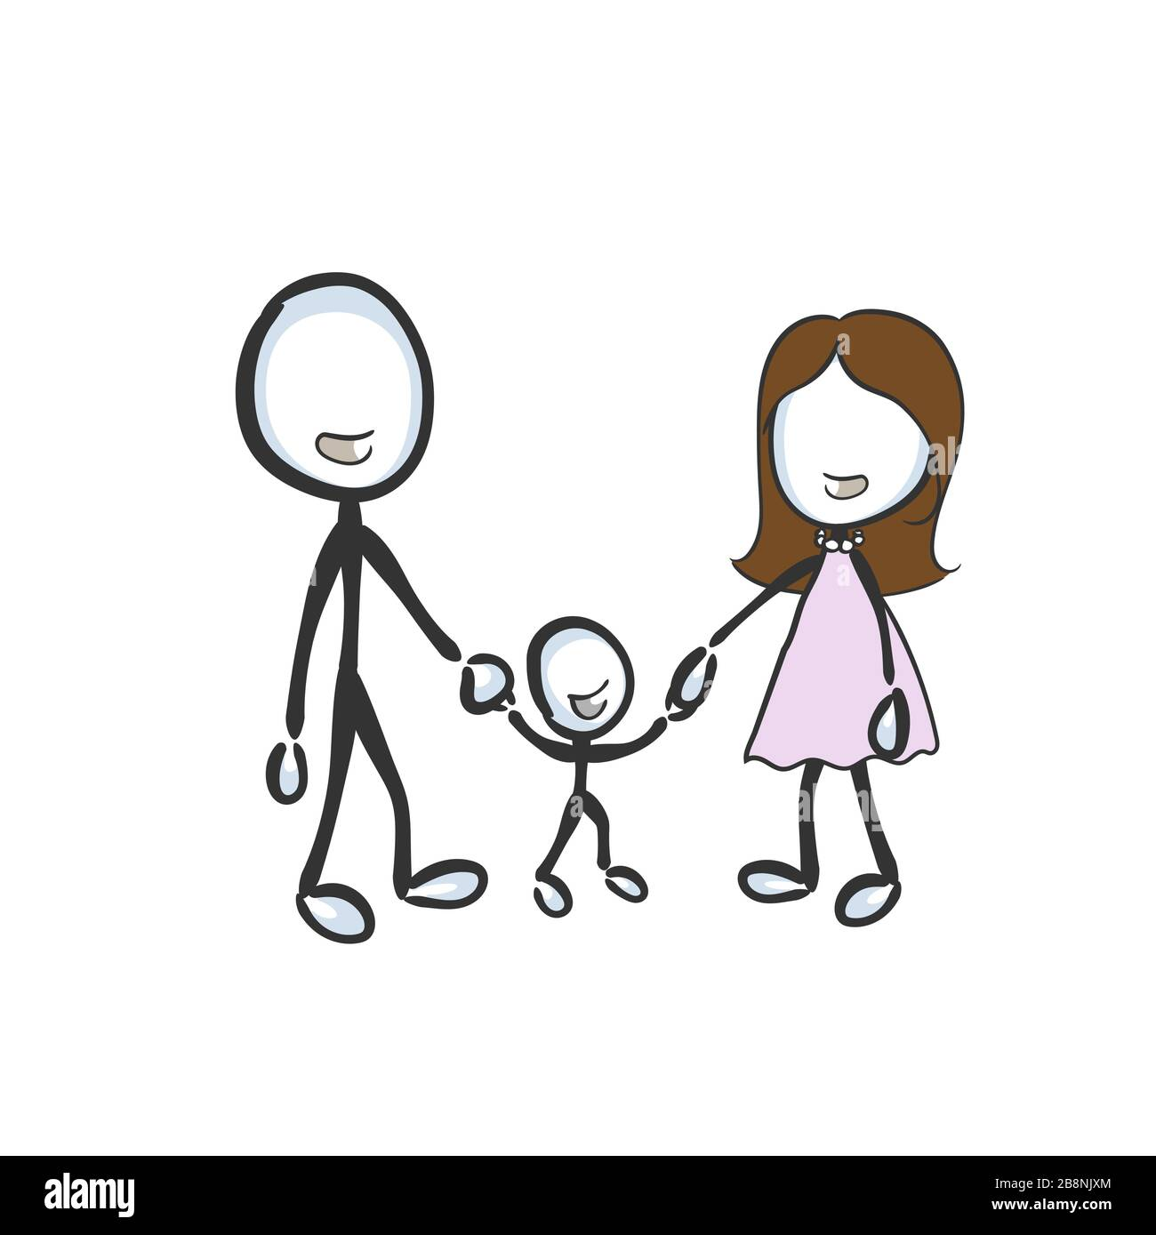
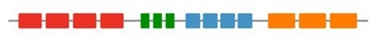
Biology
HLA A*01
HLA A*01
HLA B*03
HLA B*07
HLA C*15
HLA C*02
HLA A*01
HLA A*01
HLA B*03
HLA B*07
HLA X*0x
pMHC
HLA C*15
HLA C*02
V
(D)
J
TCRα
CDR3
TCRβ
Notes:
. What is a tcr
. Why is it important
. Whats the objective with this work
So as i have said previously my first couple of weeks where reading and understanding the biology of what i was going to be doing.
(last time i had any biology lessons was when i was 14? ) so yeah, i had no idea. I was quite blown away actually and developed a weird respect for how our bodies are able to organize themselves in this manner.
So when we get sick our body clones from our immunological system some “antibodies” to help combat the “virus” . Even i was familiar with this concept
What i had never though about is. What if the atack is present inside one of our own cells?
Our cells have to identify how discern a good and healthy cell from another one that has been infected.
For this process, multiple systems come into play
HLA -> defines the MHC presentation of the peptide pMHC. Ok now, we have a way of presenting the internal organization of the cell. We just need something to read it and act accordingly
V(D)J recombination -> generates TCR

Slide 4
TCRs
PATIENT 1
1%
Pacient 1 tcr repertoire = 10^9 unique tcrs
PATIENT 2
Uniqueness of each tcr - how do we know its effects?
We can only sample approx 200.000 per person
Similar TCRs appear more frequently with similar diseases -> Covid
If we know :
TCRA -> COVID & TCRB ≈ TCRA
Then we can assume:
TCRB -> COVID
Objective: See if there is any correlation between specific HLAs and TCRs
Notes:
Although not necessary i wanted to mention

Slide 5

Installation
Git Repository
Requirements.txt
Google Collab environment
Notes:
Although not necessary i wanted to mention

Slide 6

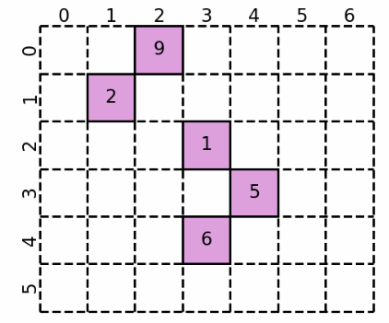
Dataset
≈ [200.000] tcrs = [ TCR1, TCR2, TCR3 …]
Public TCRs, TCRs shared by > threshold.
If threshold = 2:
Public = TCR3
1
.
.
.
The size of the dataset made this process hard to work with.
Defined a threshold of 21. Max size we can cluster (100.000 tcrs)
666
≈ [200.000] tcrs = [ …. TCR 133.199.999, TCR 133.200.000]

Slide 7
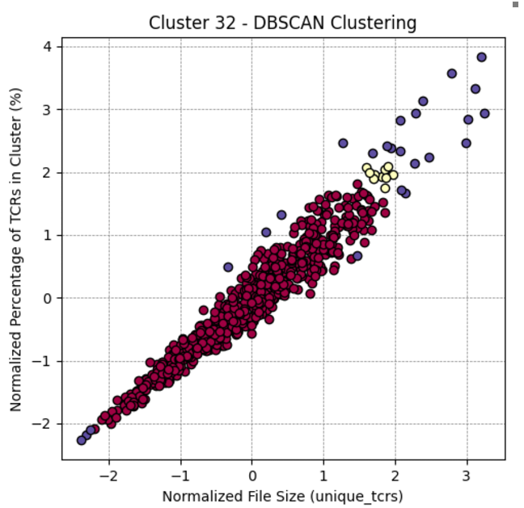
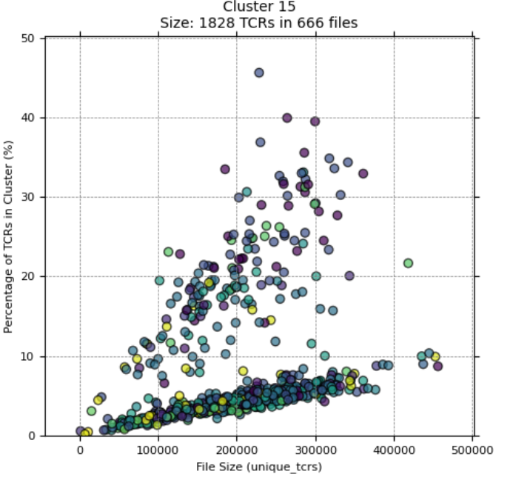
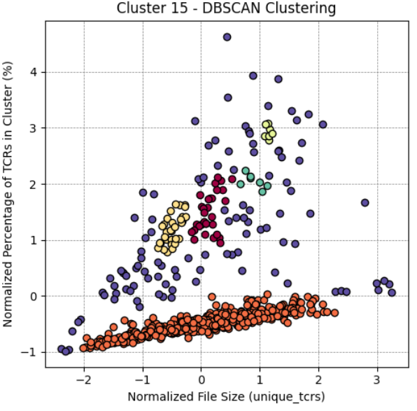
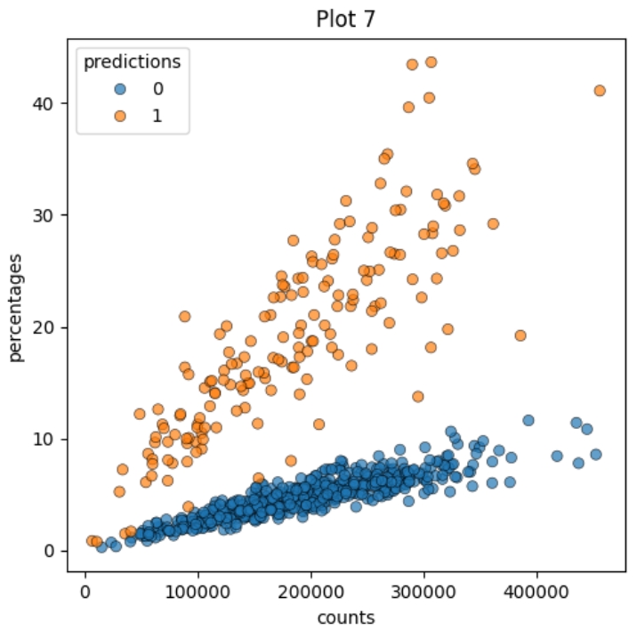
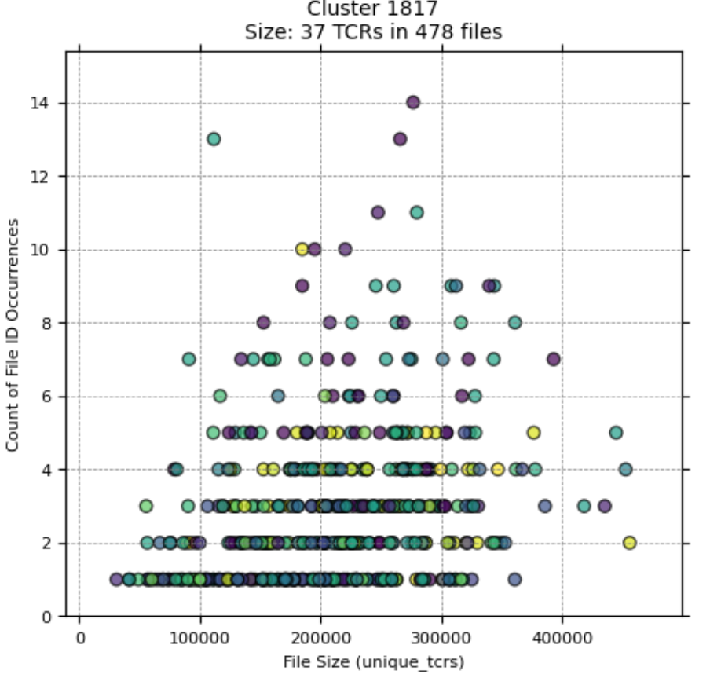
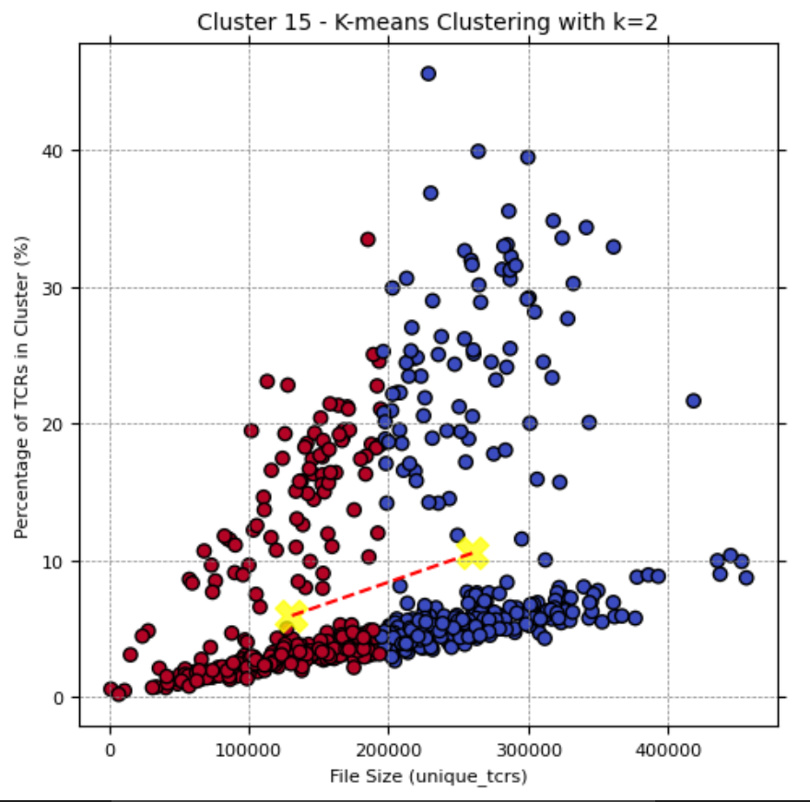
Clustering
1st - Redefine TCR, previously only cdr3. Now v_gene + cdr3
2nd - 100.000 tcrs -> 4300 clusters !!
3rd - Threshold of 120 tcrs/cluster -> 60 clusters
4th - Filter interesting clusters -> 20 clusters

Slide 8
Analysis
Remember:
We clustered x amount of tcrs together (>120)
Each dot is a different person with at least 1 tcr in the cluster.
Each patient has 6 (12*) HLA values
Do :
Fisher exact test:
For each HLA value found in the cluster
Cluster 0: Significant HLAs with p-value < 0.05
HLA: HLA-DPB1*02:02, p-value: 0.03414490325800958
HLA: HLA-DQB1*06:03, p-value: 0.00499743171306426
HLA: HLA-DQA1*01:03, p-value: 0.03581774908369885
HLA: HLA-A*30:02, p-value: 0.010645454064427224
HLA: HLA-DRB1*13:01, p-value: 0.010486453728465413

Slide 9
Conclusions
Biology is pretty cool
Working with huge datasets is a pain
Further analysis is needed
I had a nice internship

Slide 10
TCR ANALYSIS
Pablo de Vicente Abad
https://github.com/yenyyo/R1-Research_internship_1
Promotor : Pieter Meysman
Supervisor : Vincent Van Deuren

